Slide 1
Experimental Probability

Slide 2
What is Experimental Probability
-Tells us the probability of a performed experiment
The desired outcome
All possible outcomes

Slide 3
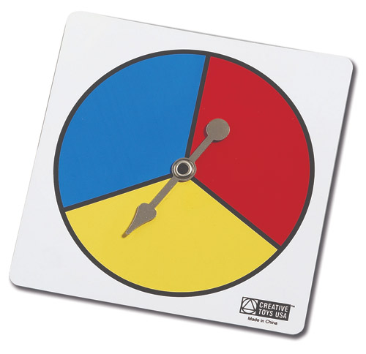
Example:
The spinner was spun 10 times and the results were as follows:
Blue was spun 3 times
Yellow was spun 5 times
Red was spun 2 times
What is the experimental probability
for each color?
Blue: (3/10)
Yellow: (5/10)
Red: (2/10)

Slide 4
Writing probability as decimals and percents
Use previous knowledge and convert the fraction to a decimal using proportions.
Blue: 3_ = _x
10 100
=30% OR .3
Yellow: 5 = x
10 100
=50% OR .5
Red: 2 = x
10 100
=20% OR .2

Slide 5
Marshmallow Toss Experiment
Toss each marshmallow 50 times in your groups
Solve for the experimental probabilities and complete the rest of the worksheet on your own.
Create a graph on your laptop of the data.
Prepare to share your results

Slide 6
Were all of the results the same?
Why do you think the experimental probability was different for each group?
Was there a difference between the marshmallows? Why do you think this is?
If you were using a large marshmallow in a coin flip what side would you choose? Why? What about a small marshmallow?

